Slide 1

Ratio Analysis
Topic 10

Slide 2

Financial Statement Analysis - Overview
Ratios are an efficient tool for interpreting financial reports
Ratios are used by management, investors, analysts and creditors
Results of ratios are presented as percentages or as ratios
A Financial Ratio is an index that relates two accounting numbers and is obtained by dividing one number by the other.

Slide 3
Analytical Techniques
.
Type of analysis | Description | Example
Ratio*** | Profitability ratio Financial stability ratio Leverage ratio | Rate of return on Assets Quick asset ratio Debt to equity

Slide 4
Overview
Percentages and ratios assist decisions makers in interpreting financial reports in the following areas:
Profitability
Effectiveness of management policies
Financial stability
Ratios must be compared with a benchmark for it to be usefully interpreted as (un)favourable as a basis of decision making.
Similarity is important as one should compare “apples to apples.”
In interpreting the results of ratios, need to compare the ratio with:
the budget for the same accounting period
the same business for a previous accounting period
a similar business in the same time period
with average ratios for that type of business (industry average).

Slide 5
Important Terms
Liquidity is the term used to describe how easily assets can be converted into cash and can then to be used to pay financial debts.
cash in the bank is completely liquid.
inventory is not as liquid, as it has to be sold and then the money collected from the purchaser.
non-current assets are not very liquid, as it usually takes much longer to sell and collect the cash proceeds.
Liquidity Ratios enable the user to evaluate the ability of a company to repay it short term debts as they fall due.
Refers to short-term and long-term solvency of a company.
Ratios that measure liquidity are:
% Working capital/Current ratio
Working capital is the excess of current assets over current liabilities.
A business must ensure that it has enough liquid assets such as cash and cash due from debtors available to meet its short term liabilities such as creditors and short term loans.
Calculating the working capital/current ratio is one way for users of financial reports to evaluate the businesses liquidity

Slide 6
More Important Terms
Gearing refers to the extent to which the assets have been financed from external sources compared to internal sources.
Also known as leverage ratios
Shows the relationship between debt financing & equity financing.
Refers to long-term solvency of a company.
A highly geared business is where the amount of external equity (loans) is high relative to internal equity (capital). A low geared business has a greater amount of capital compared to loans.
A highly geared business is in greater financial danger of being unable to pay its debts than is a business with a low level of gearing.
Ratios that measure profitability are:
% Debt to equity
% Times Interest Earned
Profitability is a measure of the ability of a business to use its assets to earn income in excess of expenses.
Ratios that measure profitability are:
% Profit Margin
% Rate of Return on Assets
Designed to help investors evaluate a business’s ability to control expenses and earn an adequate return

Slide 7
Profitability
Profit ratio
profit
Net sales
Ratio expressed as a percentage %
This ratio measures the ability of the company to generate profit from sale of goods/services

Slide 8
Profitability – Profit Ratio
High ratio: | operating income is high & operating expenses low
Low ratio: | % Selling margin is very low % Expenses are too high when compared to sales income & other operating income
Interpretations: | % This ratio must be analysed with the gross profit ratio & industry benchmarks % Some industries operate on low profit margins as their sales volume is very high (eg: discount stores) while others with a lower turnover of inventory would be expected to have a higher profit margin (such as cars)
Suggested strategies for improvement: | % Increase sales income % Reduce expenses

Slide 9
Profitability
Rate of Return on Assets ratio
Profit
Average total assets
*Finance costs are any costs associated with obtaining finance for the entity. These would include: interest on loan; interest on mortgage; interest on expense.
Ratio expressed as a percentage %
This ratio measures the relationship between operating profit & the sales that were used to earn it.

Slide 10
Profitability: Rate of Return on Assets Ratio
High ratio: | % Good performance of assets % Effective use of company’s assets to generate profit
Low ratio: | % Poor performance of assets % Ineffective use of company’s assets
Interpretations: | This ratio may be distorted by: % heavily depreciated non-current assets % Large amounts of intangible assets % Unusual income or expense items
Suggested strategies for improvement: | % Increase operating profit % Decrease average total assets

Slide 11
Liquidity
Current ratio
Current assets
Current liabilities
Ratio expressed as a ratio 2:1
This ratio measures the ability of the company to meet its short-term debts within the current financial year
Also called the Current Ratio

Slide 12
Liquidity – Current Ratio
High ratio: | High degree of assurance that current liabilities can be paid out of current assets (eg: bank)
Low ratio: | Low degree of assurance that current liabilities ca be paid out of current assets.
Interpretations: | % usually a current ratio 2:1 is satisfactory but my be lower, depending on industry benchmarks % The desired ratio depends on type, age and period in the company’s cycle % a company that has a high investment in inventories should have a higher ratio % How financially secure is this company in the short term?
Suggested strategies for improvement: | % Increase current assets (eg: bank) by increasing sales income & monitoring expenses closely % Decrease current liabilities: (eg: short term loans could be renegotiated into long term loans if appropriate)

Slide 13
Leverage
Debt to Equity ratio
Total Liabilities
Equity (end)
Ratio expressed as a ratio 1:1
This ratio indicates the company’s financial risk related to the amount of debt financed externally compared with internal owner’s (equity) finance.

Slide 14
Leverage – Debt to Equity Ratio
High ratio: | company may have trouble paying the loans off due to high external borrowings. (highly geared)
Low ratio: | company has minimum external borrowings and can easily pay off loans. (lowly geared)
Interpretations: | % There is one measure of long-term solvency. % Can the company meet its loan repayments from external parties?
Suggested strategies for improvement: | % Reinvest profit back into business % decrease owner’s drawings % additional capital % Reduce current & non-current liabilities: (eg: short term loans could be renegotiated into long term loans if appropriate) % select external financing with low rates of interest.

Slide 15
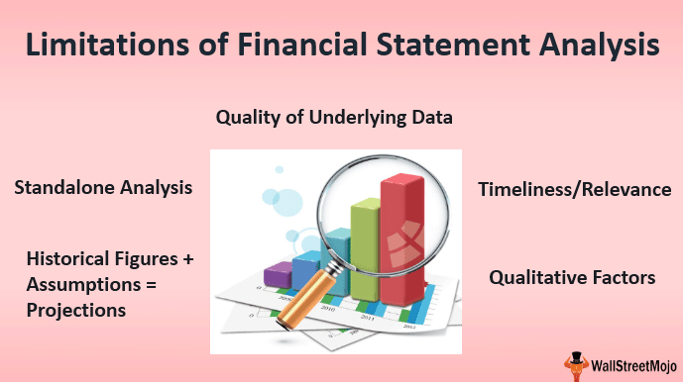

Slide 16
Limitations
 Ratios mean nothing by themselves. To be useful they must be compared with:
 Previous accounting periods
 A competitor of similar business
 An industry average or benchmark
Ratios need to be calculated over a number of years before trends become evident
Ratios highlight trends but do not identify the problem itself.
Companies may not be comparable due to factors such as size, diversification of product lines, financial risk, business risk, different markets.
Ratios can be manipulated.
Knowing that certain ratios are calculated at year end, management may attempt to improve a ratio by window dressing

Slide 17
Limitations
Not always possible to compare ratios between companies due to inconsistencies in accounting methods eg: different stock valuations
Could be limited disclosure of information, which may make some ratio calculations difficult
Analysis is performed on historical data for forecasting future performance. The historical data may be out of date due to the state of the economy, business environment, internal factors such as change in management.
Ratios calculated are based on historical cost. Failure to adjust for inflation, changes in technology or changes in the values of assets may result in some ratios providing misleading information on a trend basis and in any comparison between companies.

